Slide 1
Giving Trends in Healthcare
GG+A Special Analysis: Giving USA 2015 Annual Report on Philanthropy
June 16, 2015
Featuring GG+A Senior Executive Vice President and Managing Director
G. ROBERT ALSOBROOK
Interviewed by Deb Taft, GG+A Senior Executive Vice President and Managing Director

Slide 2
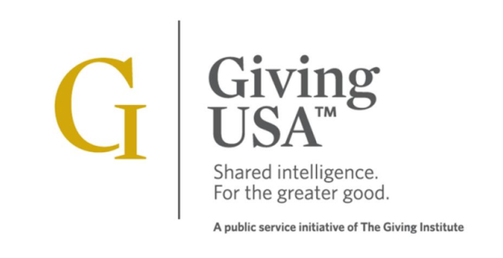

GG+A Special Analysis: Giving USA 2015
Giving USA: The Annual Report on Philanthropy was first published in 1955 and is the longest running publication on charitable giving in the United States. The report is published by the Giving USA Foundation, a public service initiative of The Giving Institute™. Founded in 1935, the Institute advances philanthropy and promotes ethics in the fundraising profession.
Research and writing for the annual report is conducted by the Indiana University Lilly Family School of Philanthropy.
Grenzebach Glier and Associates (GG+A) is a member of The Giving Institute, a member of the Editorial Review Board, and a sponsor of the annual report.
This four-part special presentation features GG+A experts in philanthropic management on select findings of the report. The views expressed herein are those of Grenzebach Glier and Associates.

Slide 3
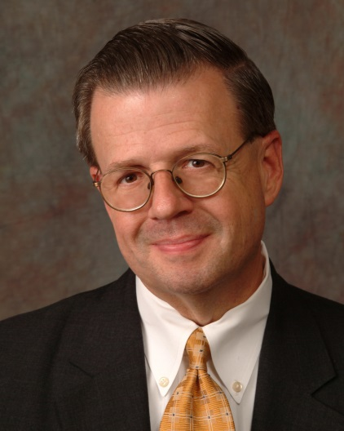
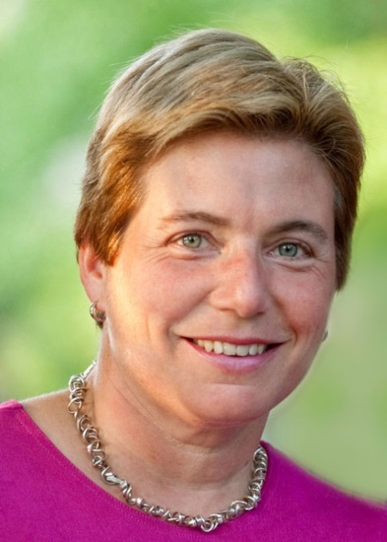
GG+A Special Analysis: Giving USA 2015
Session 4 - Healthcare
Our Speakers
G. Robert Alsobrook
Senior Executive Vice President and Managing Director
Grenzebach Glier and Associates
Deb Taft
Senior Executive Vice President and Managing Director
Grenzebach Glier and Associates

Slide 4
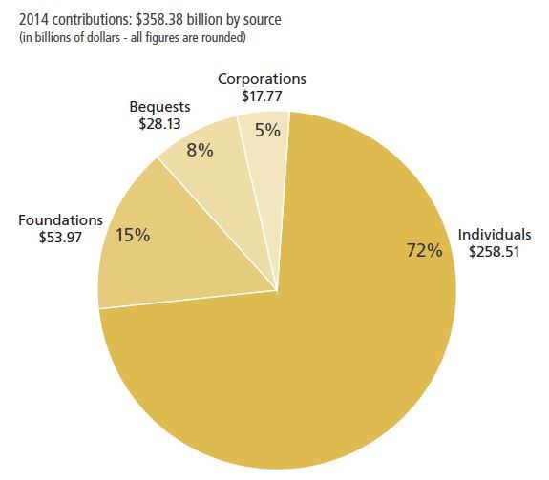
2014 Contributions by Source
Source: Giving USA 2015

Slide 5
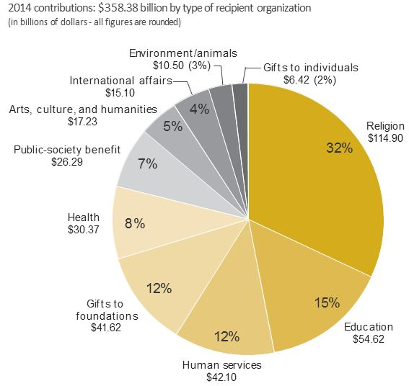
2014 Contributions by Type of Recipient Organization
Source: Giving USA 2015
Notes:
Religious organizations received the largest share of charitable dollars in 2014, at 32 percent of the total.
The education subsector received the second-largest share of charitable dollars in 2014, at 15 percent of the total.
Human services organizations received 12 percent of total charitable dollars in 2014, ranking third of total gifts received.
Gifts to independent, community, and operating grantmaking foundations amounted to the fourth-largest share of charitable dollars in 2014, also with 12 percent of the total and just behind human services.
The health subsector received the fifth-largest share of charitable dollars in 2014, at 8 percent of the total.

Slide 6
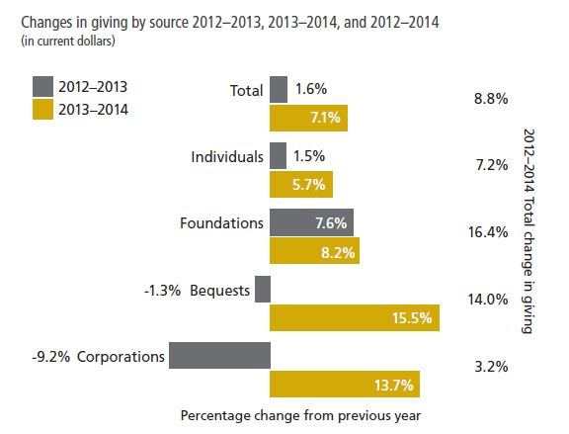
Changes in Giving by Source
Source: Giving USA 2015

Slide 7
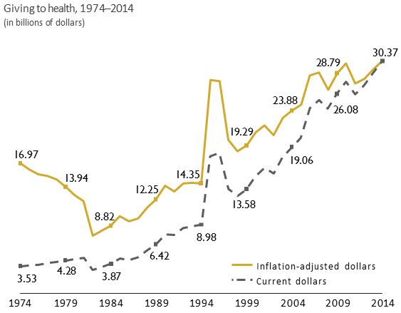
Giving to Health, 1974 - 2014
Source: Giving USA 2015
Notes:
Contributions to the health subsector comprised 8 percent of all donations received by charities in 2014.
Giving to health organizations grew 5.5 percent in current dollars from 2013, totaling $30.37 billion. Adjusted for inflation, giving to health increased 3.8 percent between 2013 and 2014.
For the year 2014, contributions to health totaled the highest inflation-adjusted value recorded to date. The year 2010 saw the second-highest total amount to health, at $30.05 billion, followed by $29.27 billion for the year 2013.
Nonprofit-sector reports indicate that fewer health organizations saw increases in charitable contributions in 2014 compared with 2013.38 Online giving to the health subsector appears to have been strong, but offline giving was weaker.

Slide 8
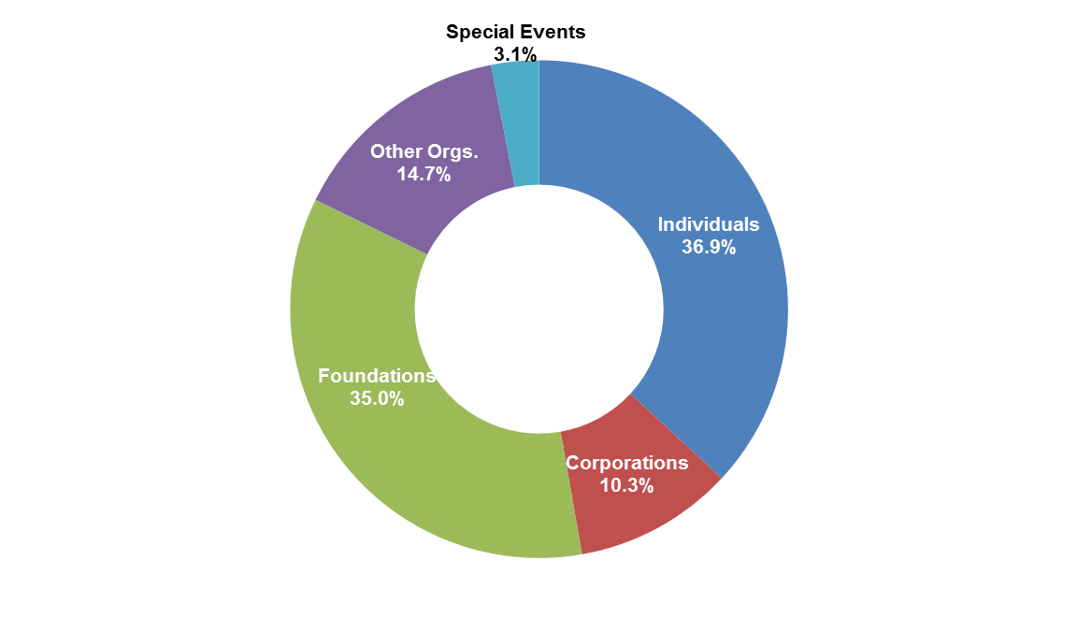
Average Total Private Support (cash) by Source
All AAMC Institutions (2013 data latest published)
2013
Source: American Association of Medical Colleges (AAMC), Annual Development Survey

Slide 9
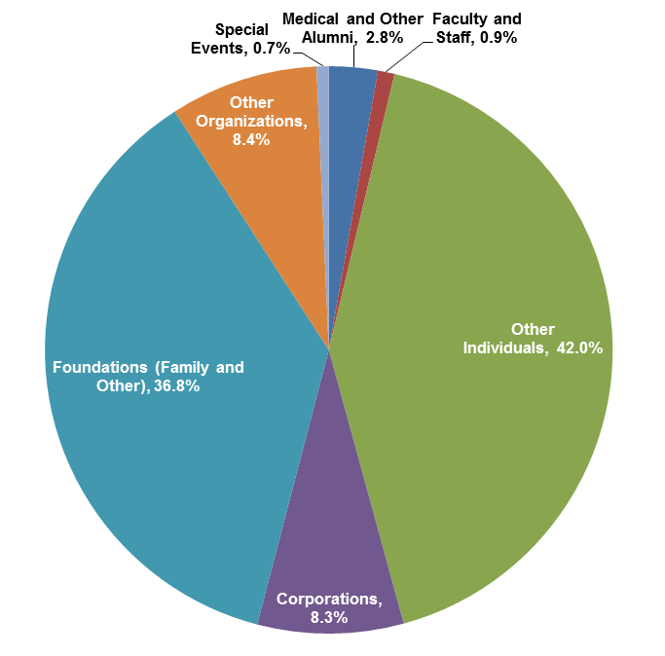
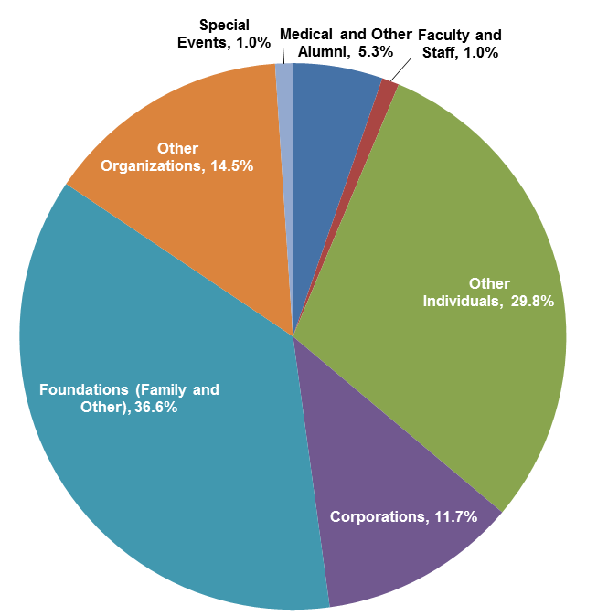
Total Private Gift Support (Cash) by Donor Source,
Three-year Average, FY11-FY13 (2013 data latest published)
Mean of Top 10 AAMC Institutions*
Mean of All AAMC Institutions
*The Top 10 AAMC Institutions include: Stanford University School of Medicine; University of California, San Francisco, School of Medicine; Memorial Sloan-Kettering
Cancer Center; Johns Hopkins Medicine; Mayo Medical School; NYU School of Medicine; The University of Texas MD Anderson Cancer Center; Icahn School of Medicine
at Mount Sinai; Massachusetts General Hospital; and University of Pennsylvania Health System.
Source: Association of American Medical Colleges (AAMC)

Slide 10
GG+A Special Analysis: Giving USA 2015
Session 4 - Healthcare
Reflections on the significance of these findings:

Slide 11
Trends in Healthcare and Academic Medicine Philanthropy
Increased scrutiny on ROI
Sharpened focus on gift officer performance metrics
More challenges to engaging top volunteer leadership
Strong emphasis on physician involvement in and engagement with development

Slide 12
Trends in Healthcare and Academic Medicine Philanthropy
Formalizing grateful patient fundraising efforts targeting major gift initiatives
Intensified leadership expectations of “quick” fundraising results
Heightened donor expectations of broader collaboration in medicine and science
Stewardship programs increasingly seen to be major factor in successful fundraising programs

Slide 13
Key Observations about Large Healthcare Donors
Giving from individuals is a key source of private support
7-, 8- and 9-figure gifts are trending upward
Steady resource support for major/principal gift staffing and programming
Investment in donor relations and engagement programs
Significant resources deployed to support data analysis and management
Increased program support in ongoing stewardship initiatives at the major gift level

Slide 14
GG+A Special Analysis: Giving USA 2015 - Healthcare
This concludes our presentation.

Slide 15


Extraordinary. Sustainable. Philanthropy.
For more than 50 years, GG+A has made it our mission
to advance your mission.
To help extraordinary organizations around the world
grow in every way.
To build sustainable cultures of best practices.
To develop leaders and effective, successful teams
of fundraising professionals.
To support volunteer engagement, and assist in the creation of
evidence-based, strategic programs that meet the unique
philanthropic goals of each and every one of our client partners.
___________________________________________________________________
To discover how GG+A can help you reach your goals, please call us
at 312.372.4040 or send us an email at contactus@grenzglier.com.
www.GrenzebachGlier.com

