Slide 1
Welcome! Please wait for the host to start the session.
Making the Case for Cultural Institutions:
the Core Argument for Support
January 15, 2020
Chris Begley
Senior Vice President
cbegley@grenzglier.com

Slide 2
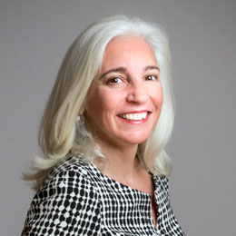
Welcome + Introductions
In 30 seconds: GG+A and me
Chris Begley

Slide 3
Objectives for Session
Participants will:
Understand key elements in making the case
Be able to articulate what differentiates their organization
Gain resources for making the case for arts and culture

Slide 4
Notes:
We thought today’s session would be important because there are a lot of philanthropic dollars out there, and over last 20 years or so, an explosion of nonprofits in every sector vying for those dollars.
Of the $427 billion dollars given to charity in 2018, only 5% went to arts and culture ($19.49 billion). Given that, its so important that our arts and culture organizations can compete for those philanthropic dollars through really clear and compelling messaging.
So let’s get started.

Slide 5
Three Key Principles
Focus on your mission
Celebrate what differentiates your institution
Be clear
(would your grandmother understand your argument?)

Slide 6
Your Mission
Art Institute of Chicago
The Art Institute of Chicago collects, preserves, and interprets works of art of the highest quality, representing the world’s diverse artistic traditions, for the inspiration and education of the public and in accordance with our profession’s highest ethical standards and practices.
Oakland Museum of California
The mission of the Oakland Museum of California is to inspire all Californians to create a more vibrant future for themselves and their communities.
Sarasota Orchestra
The mission of Sarasota Orchestra is to engage, educate, and enrich our community through high-quality, live musical experiences.
Notes:
So mission statements are generally fairly broad. Their purpose though is to bring clarity and focus to everything you do. Here are examples of mission statements from three very different organizations that GG+A works with. The point is that your mission drives your work and your funding priorities, so you can always link back to your mission when making the case for a gift.

Slide 7
Celebrate What Differentiates Your Institution
Time for some thinking…
Why is your institution particularly important to your city?
Dedicated to specific art or artists?
Stand out for specific work? (education, social justice)
Notes:
Even if you think you know the answer to what makes you different as an organization, spend some time really thinking about this. What makes you unique and special as an organization—are you the only major art museum in your city? Do your programs reach a majority of underserved students? What’s unique about your collection, how you display and conserve it? Think about every angle.
But what’s important is marrying that uniqueness to what will matter to donors.
At the Met, we consistently emphasized that we shared with the public the very finest examples of human creativity from across the globe (message of excellence and encyclopedic), and the numbers of people we reached, in the galleries, in programs, and on the web (message of our impact).
One example that stands out to me is the Brooklyn Museum. About 10 or more years ago the Brooklyn Museum stopped trying to compete with the museums in Manhattan and started celebrating being a uniquely Brooklyn institution and embraced the community around it. It started free community programming and really inviting the public in for big, fun, splashy events. Now its seen as community center and anchor, instead of a stodgy, elitist institution. They’ve been successful by being consistent and clear in their messaging, providing relevant programming, but they haven’t lost sight of their mission as a great art institution.

Slide 8
Factors That Influence Giving Decisions
Engaging with donors based on their values and interests carries far more weight than arguments based on organizational need.
The 2018 U.S. Trust® Study of High Net Worth Philanthropy, Page 26
Notes:
So why is it important to talk about your institution from the donor’s perspective, marrying your value as an institution to what donors’ value?
These are results from the 2018 U.S. Trust® Study of High Net Worth Philanthropy
Conducted in partnership with the Indiana University Lilly Family School of Philanthropy
Conducted biennially since 2006
Criteria include:
Minimum household income of $200,000 and/or net worth of $1 million (excl. home)
1,646 study participants
Median annual household income ~$350,000.
Median net worth $2 million
What this shows is that it’s never a good idea to talk about funding opportunities in terms of what you need as an organization. You want to consider your impact and outcomes. This really comes down to knowing your donors, both as a group but especially individually. For your large principal and major gift proposals, you will want to connect what is important to that individual with what you want to accomplish as an organization. To be able to do that, major gift officers have to listen really closely and get to know their prospects well.
Let me give you an example. I began my career in fundraising simply because I fell in love with art and wanted to be around it. And I fell in love with art only because I had free access to it—I did a study abroad program in London as an undergraduate and discovered the National Gallery of Art as a free thing to do, and I used to go every single day. I could do that only because it was free. So if I were a big donor, it would be important to know that story, because then you would know that you should probably ask me to support free admission or programs. That’s what will resonate with me, and align with my personal values.

Slide 9
Giving for Impact
Making a positive impact in society is an important goal for the wealthy, and this has a strong effect on their philanthropic behavior.
The 2018 U.S. Trust® Study of High Net Worth Philanthropy, Page 31
Notes:
This is from the same study, and highlights that donors don’t just want to simply give you money, they want to know what impact they are having—on the organization and your ability to carry out your mission, on your audiences, and on the community at large. So let’s talk a little bit more about impact. This is why the argument for general operating support is such a hard sell—it’s really difficult to make that seem urgent, compelling, and impactful. It can’t just be about keeping the lights on. Are you providing arts education to underserved students and why is that important? Are you to trying to attract the very best talent—dancers, musicians, curators, conservators—and why is that important? When you are trying to make the case, ask yourself, why should the donor care? Why is our success important, and to whom? It’s in asking these questions that you can answer the impact question.

Slide 10
Be Clear: Philanthropic Message Examples
“Open doors for the next generation. A gift to the Art Institute of Chicago helps ensure access to the museum’s ever-growing permanent collection, world-class exhibitions, and educational programs for visitors of all ages and backgrounds.”
Notes:
I wanted to share just a couple of examples of what I think are very clear and direct messages that touch on the organization’s importance, what funds will support, and why that’s important. They are brief annual fund messages but provide a snapshot of the kind

Slide 11
“When you make a gift to the Taos Art Museum, every dollar goes straight to the preservation of the Fechin House and Studio, our nationally-recognized exhibitions, educational experiences, and beloved events. Through your donation, you directly impact the visitors and artists who find inspiration here.”

Slide 12
Key Elements of the Case Checklist
The case articulates core messages
Who we are (mission and accomplishments)
Where we’re going (vision, aspirations; answers why now?)
What distinguishes us from others (key competencies)
Why our success is important, and to whom (impact)
What we need to achieve our aspirations (funding initiatives)
Why prospective donors should help advance our cause through financial support (connects your mission with donor values)
Functional details: steps, timeline, budget, leadership
Notes:
I wanted to share just a couple of examples of what I think are very clear and direct messages that touch on the organization’s importance, what funds will support, and why that’s important. They are brief annual fund messages but provide a snapshot of the kind

Slide 13
Strategic Partnerships
Donor’s interests
Align on shared objectives
Your funding priorities
Community
needs
Winning Proposition
Notes:
What you are trying to achieve is this alignment, which becomes your philanthropic proposition.

Slide 14
Resources To Help Make Your Case
Your institutional annual report
Your institutional annual report
Americans for the Arts https://www.americansforthearts.org/
American Alliance of Museums https://www.aam-us.org/
Giving USA annual report https://givingusa.org/
Notes:
Americans for the Arts released Americans Speak Out About the Arts in 2018, one of the largest national public opinion surveys of American perceptions and attitudes towards the arts and arts funding. The new research demonstrates that Americans continue to be highly engaged in the arts and believe more strongly than ever that the arts promote personal well-being, help us understand other cultures, are essential to a well-rounded education, and that government has an important role in funding the arts.
A national sample of 3,023 adults were polled online in May 2018 on topics such as the importance of arts education, support for government arts funding, personal engagement in the arts, and personal and community benefits that come from engaging in the arts. These are messages that you can use to connect with your donors. That first sub-bullet, 4 in 5 Americans believe that the arts are a positive experience in a troubled world, resonates today and especially resonated after 9/11. I was at the Met, and we thought about—what can we do? The answer was to offer a place of solace, hope, and inspiration around the very best in humankind. And that was our message during that time.
American Alliance of Museums and Giving USA are also good resources for data points and information about the arts that can be useful in building your case, so I encourage you to check them out. These kinds of resources can provide you data on the importance and effects of arts education, the importance of the arts to health and well being, how cultural contributes to society and so forth, to help you build the case of why your work is important.

Slide 15
4 in 5 Americans believe that the arts are a
positive experience in a troubled world.

Slide 16
68% of Americans agree that the arts improve healing and the healthcare experience.

Slide 17
94% believe students should receive an education in the arts in elementary school, middle school, and high school.

Slide 18
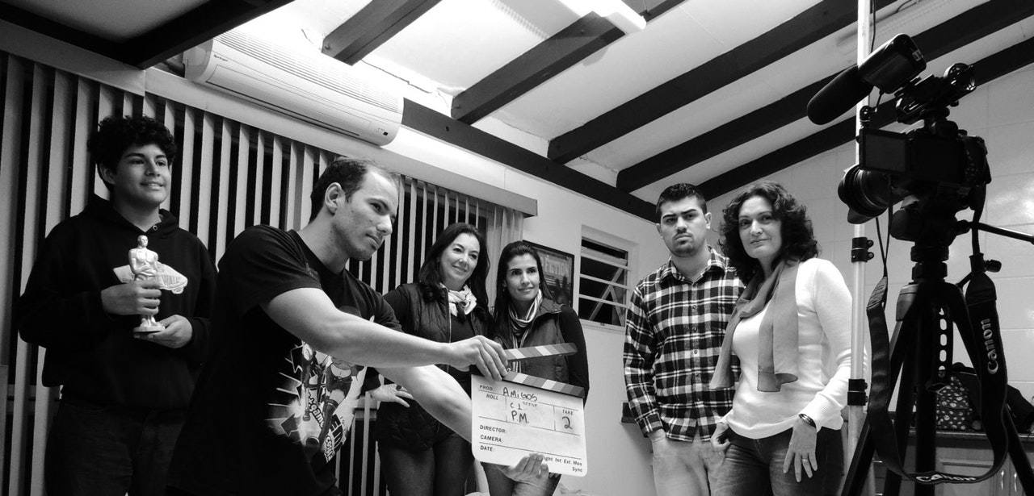
90% agree arts institutions are important to quality of life

Slide 19
Your Questions?

